Slide 1
清華大學資訊工程系 面試簡報
受試者：板橋高中吳邦寧

Slide 2
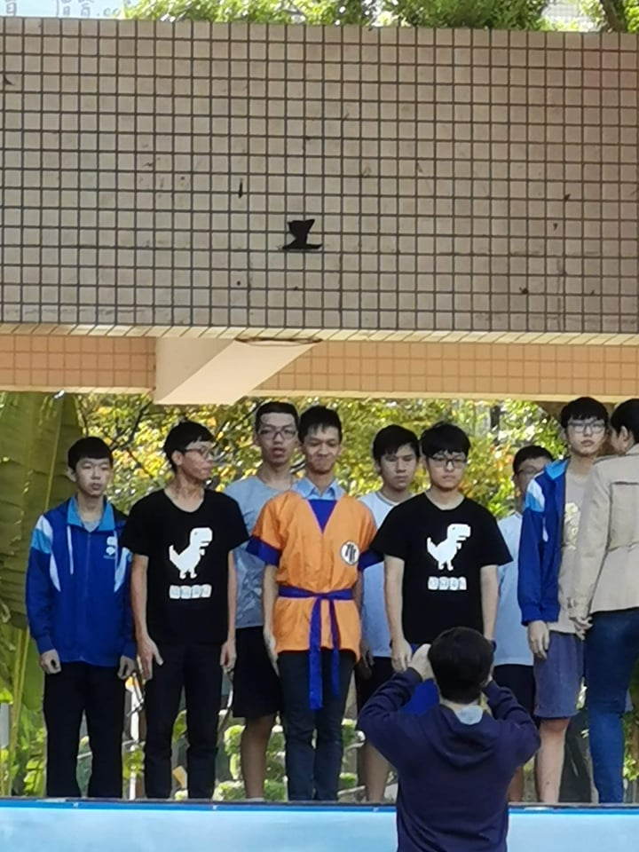
個人簡介 – 吳邦寧
板橋高中資訊社社長--
立志帶領資訊社成為全校最屌的社團
終於成為…「那個傳說中的笨蛋」
比賽頒獎盜攝留念

Slide 3
英文能力證照
なし

Slide 4
Talents/Hobbies
Algorithm
Information Security
Project Development
Machine Learning

Slide 5
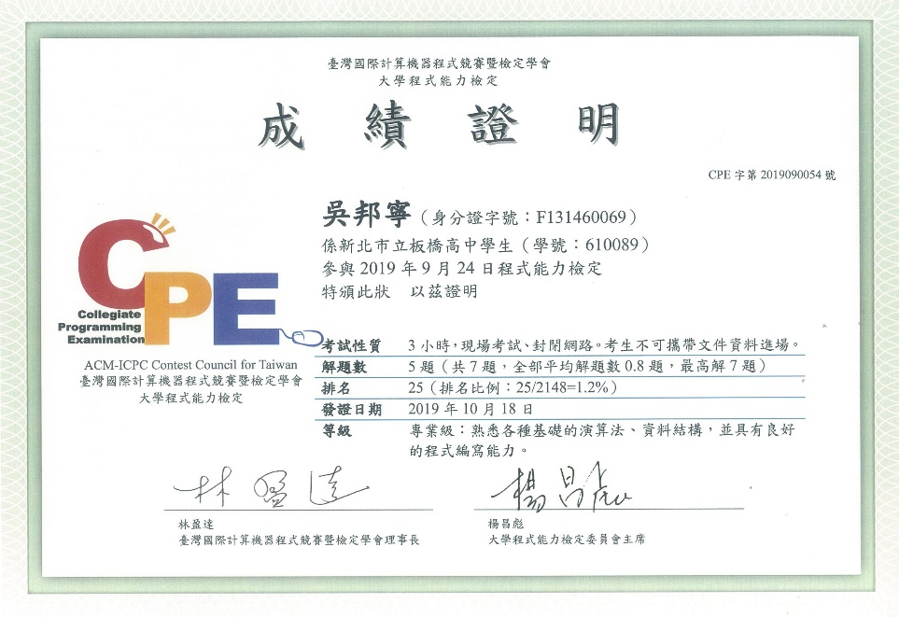
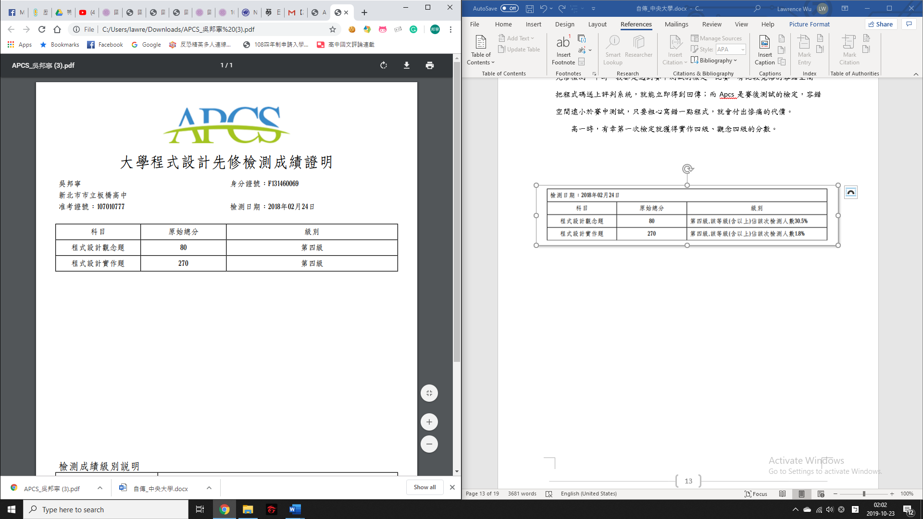
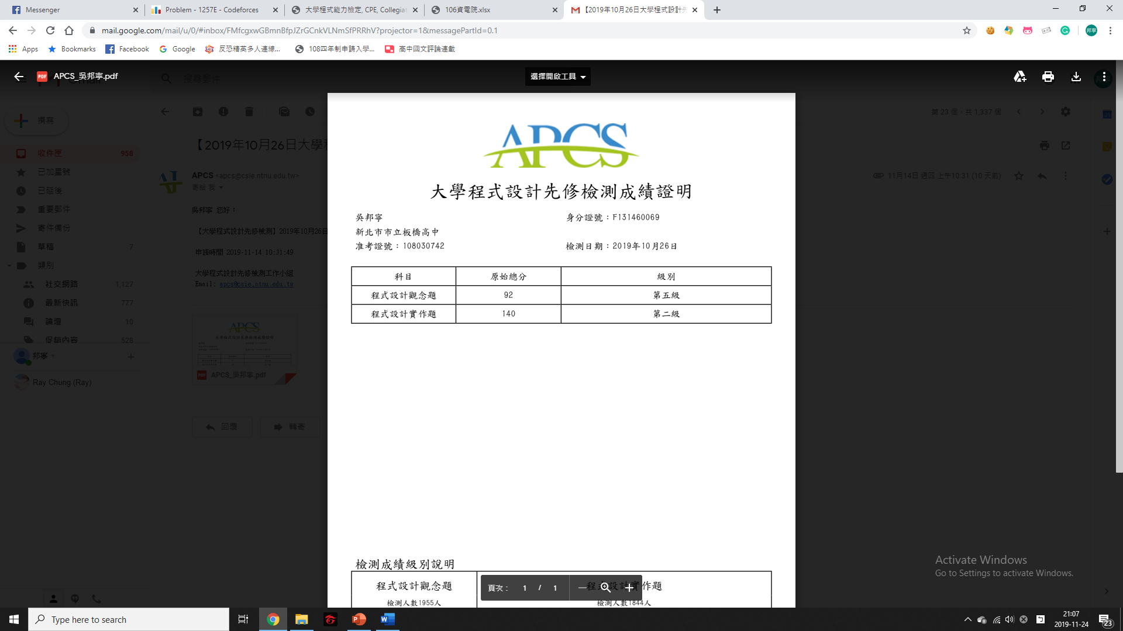
Algorithm(Certificates)
CPE
5/7 Problems solved
Reached multiple university graduation threshold
Apcs
Conception: 5/5
Implementation: 4/5

Slide 6
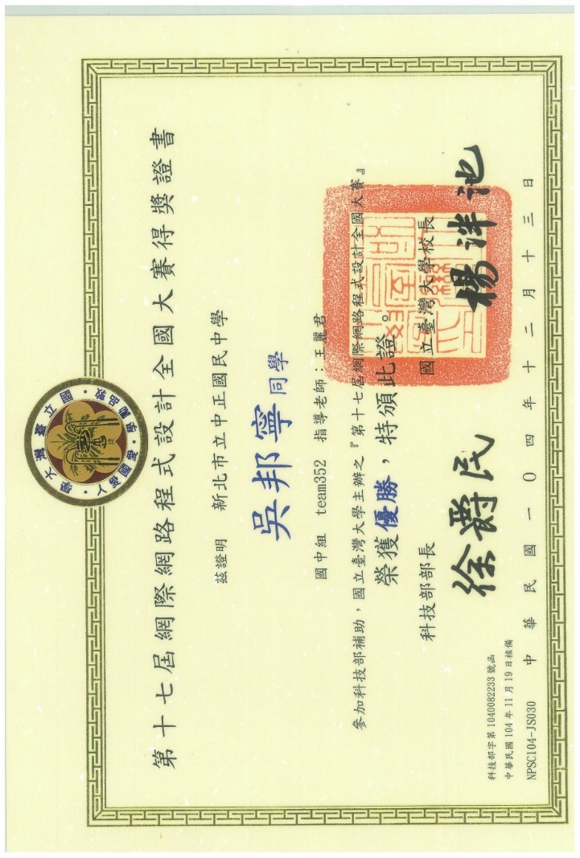

Algorithm(Competition)
資訊學科能力競賽
New Taipei City Rank 3rd
Npsc
National Rank 7th

Slide 7
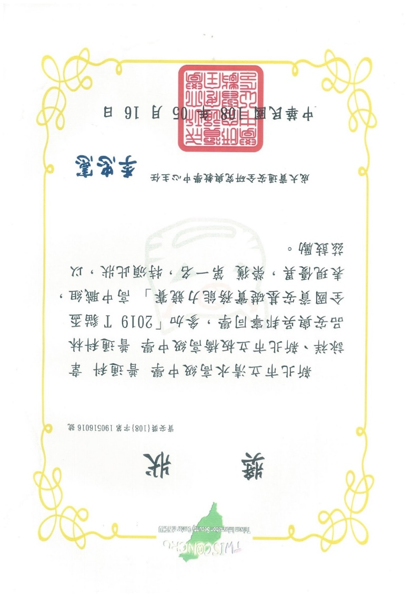
Information Security
T貓盃
National Rank 1st
Gold Shield
National Finalist
Jobs
Cryptography
Misc
Web

Slide 8

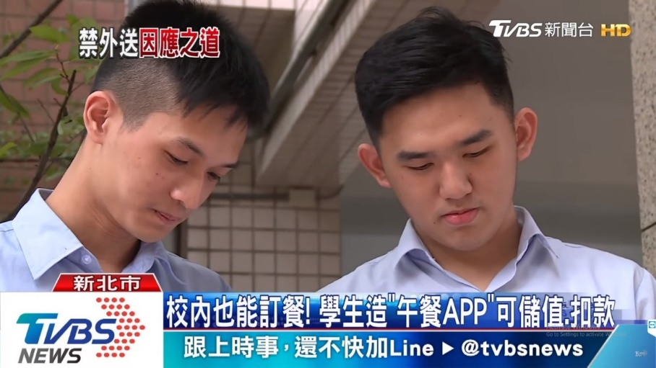
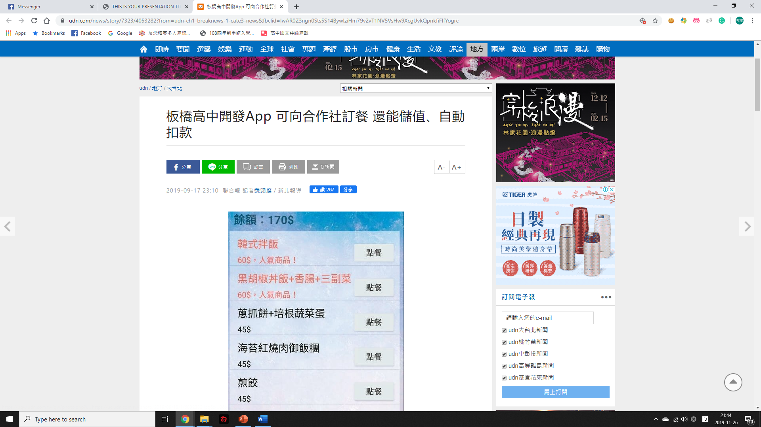
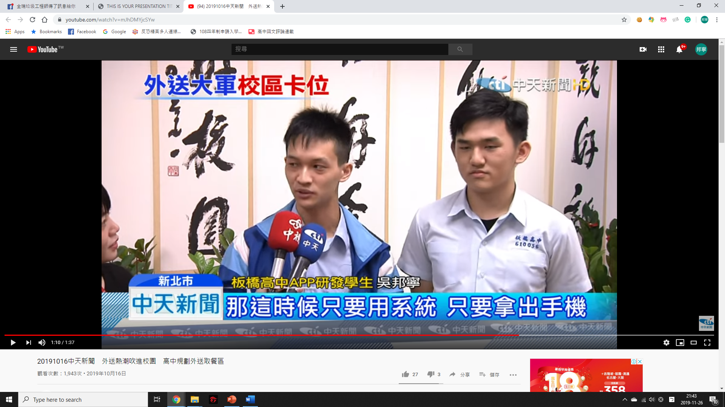
Project Development
Dinner System
https://dinnersystem.com
News
TVBS
中天
聯合報

Slide 9
Project Development
SQL Deadlock
Async optimization
白翔云
Languages | Purpose
HTML + CSS + JQuery | Frontstage (For students)
C# | Frontstage (For factories)
C# | Plugin (For payments)
Php + MySQL | Backstage

Slide 10

Machine Learning & Science Fair
New Taipei City Science Fair
優等
Goals
How many orders tomorrow
Achievements
Reached 92% of accuracy

Slide 11
未來展望
良禽擇木而居，良臣擇主而事，良生擇校而習
機器學習、神經網路
星期幾、班級與點餐有強烈相關性
未完成的研究
算法、資安競賽
NCPC
Gold Shield
拯救地球，維護世界和平！

Slide 12
簡報結束，敬請指教

